Slide 1
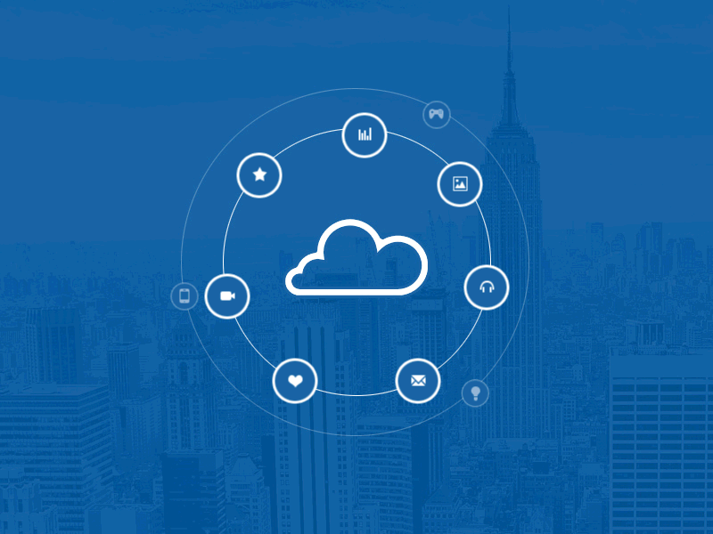
Internet of Things
“The Smartphone technology was big – the IoT is going to be a lot bigger”

Slide 2
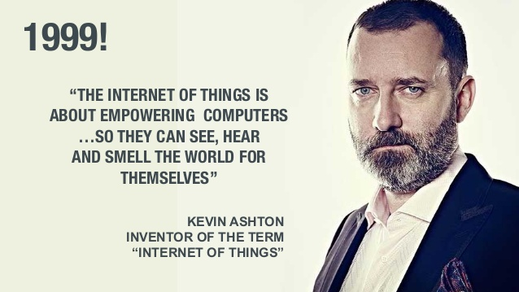
Who coined the name IoT?..

Slide 3
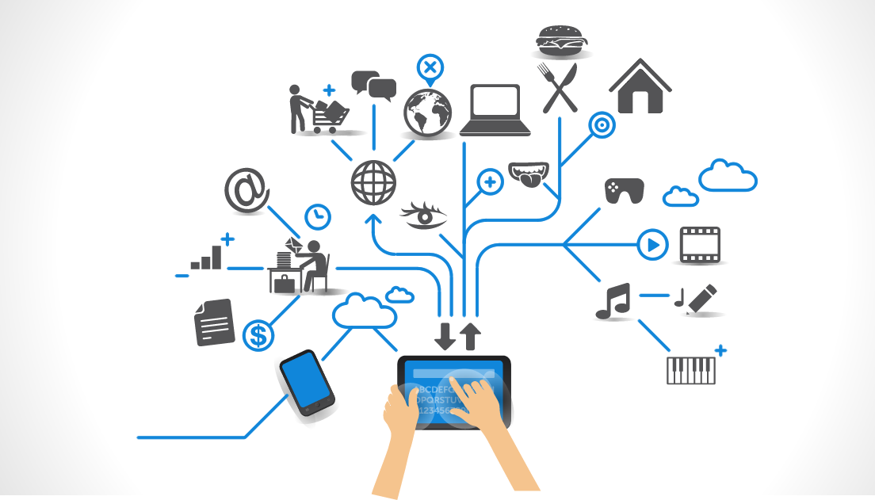
What is Internet of Things ?..
Connecting any device to Internet and to other connected devices
Network of Physical objects - devices, vehicles, buildings and other items embedded with electronics, software, sensors, and network connectivity—that enables these objects to collect and exchange data

Slide 4
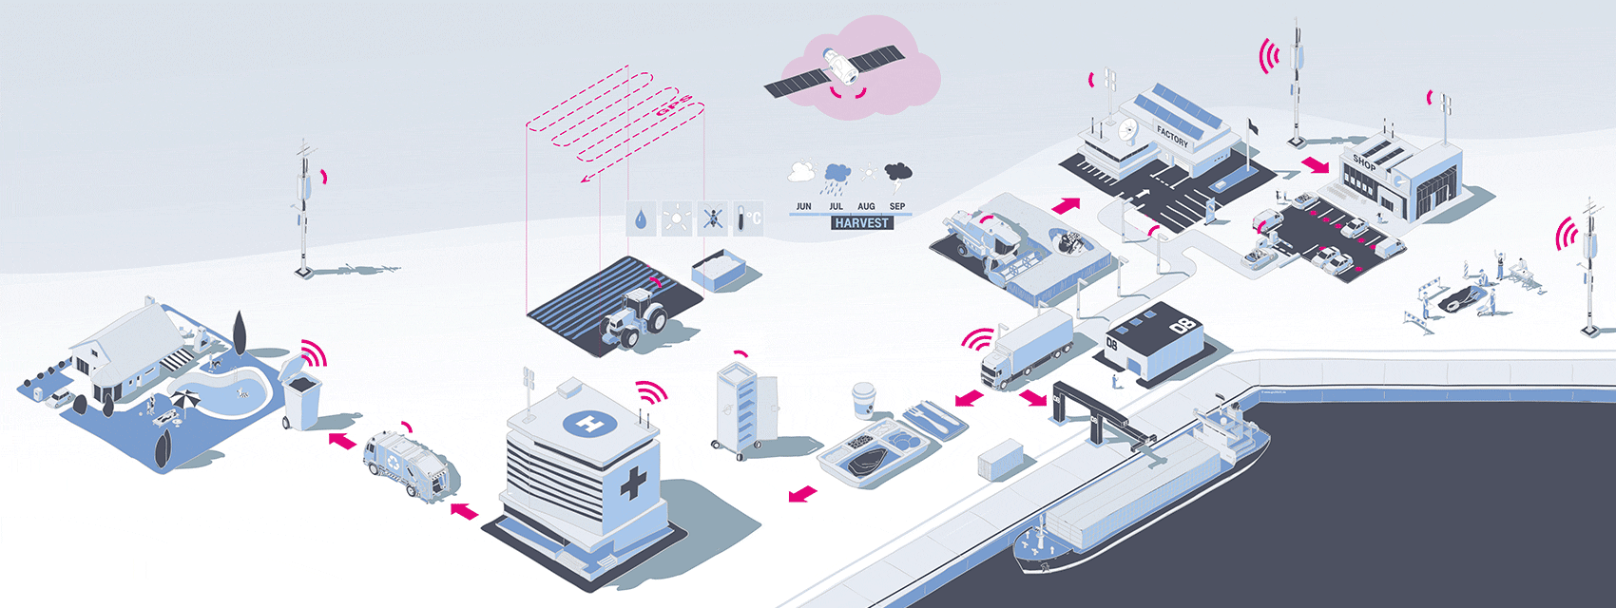
Is it limited to just connecting devices ?..
No…

Slide 5

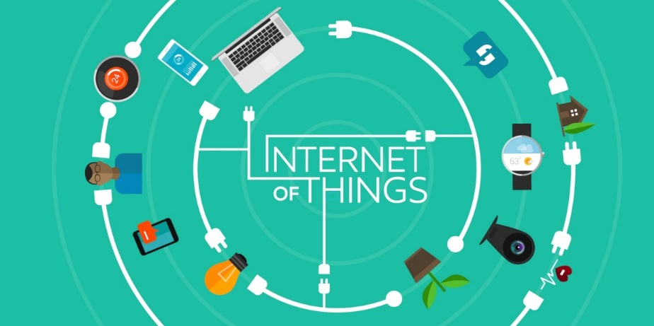
Idea: Move from Internet of People 🡪 Internet of Things
Internet appears everywhere in the world
It is primarily connection between people
Internet of Things is a plan to connect things also using the same medium

Slide 6
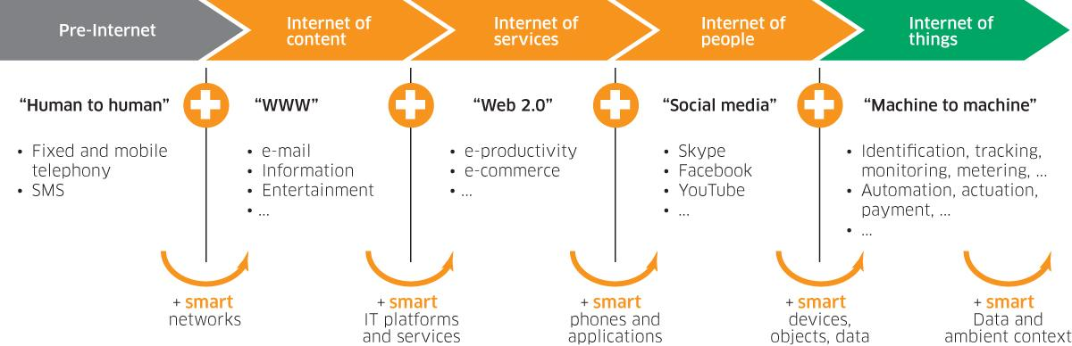
Internet of Things - Evolution

Slide 7
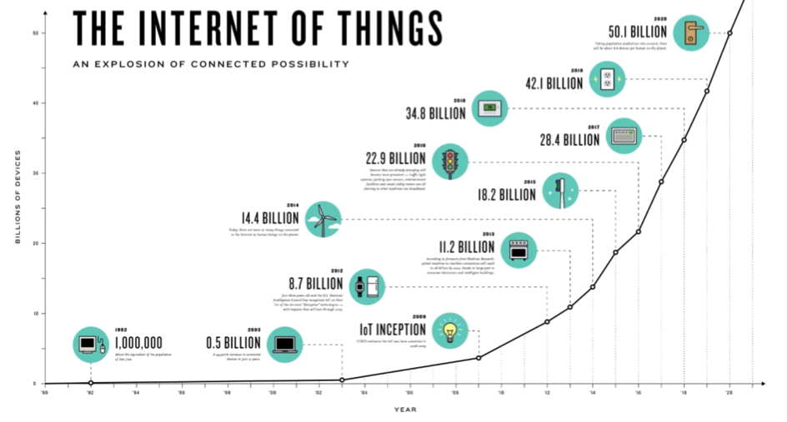
Survey…

Slide 8
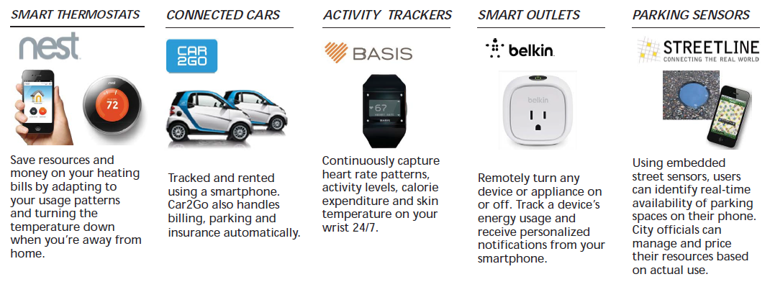
Some popular IoT devices already in the market...

Slide 9
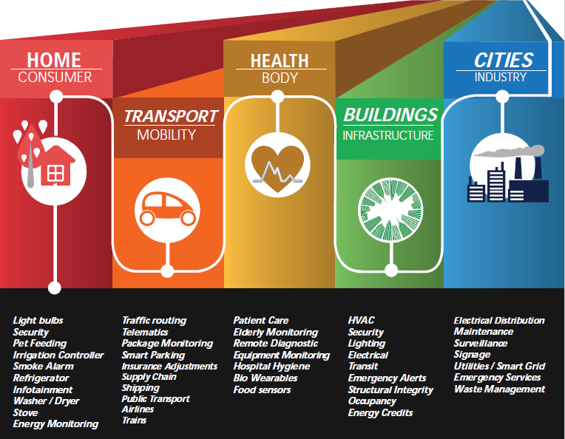

Slide 10
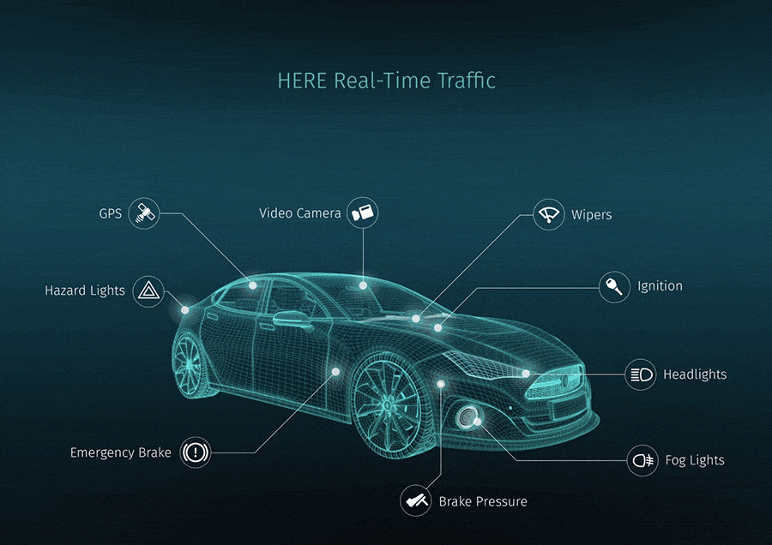
Let’s take an example…

Slide 11

These Smart things are combination of

Slide 12
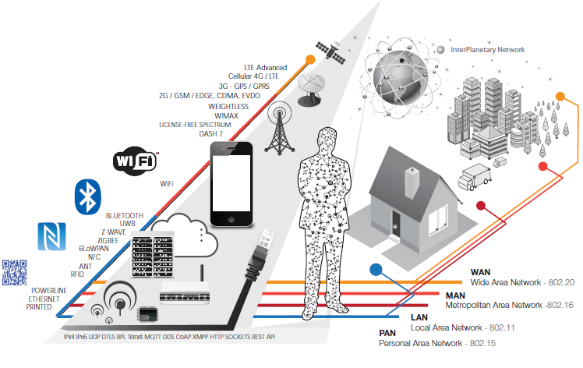
Communication Channels

Slide 13
IoT Technologies
Hardware (Device)
Communication Technology
Protocols for IoT
Software (IDE)
IoT Analytics
Cloud Platforms

Slide 14
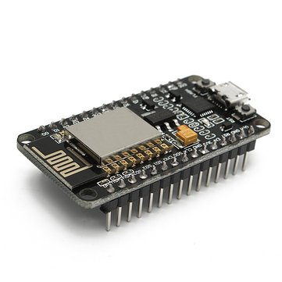
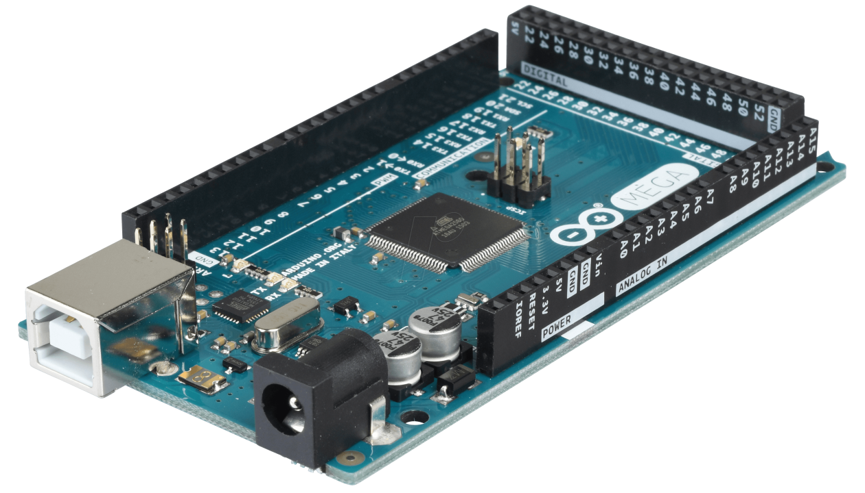
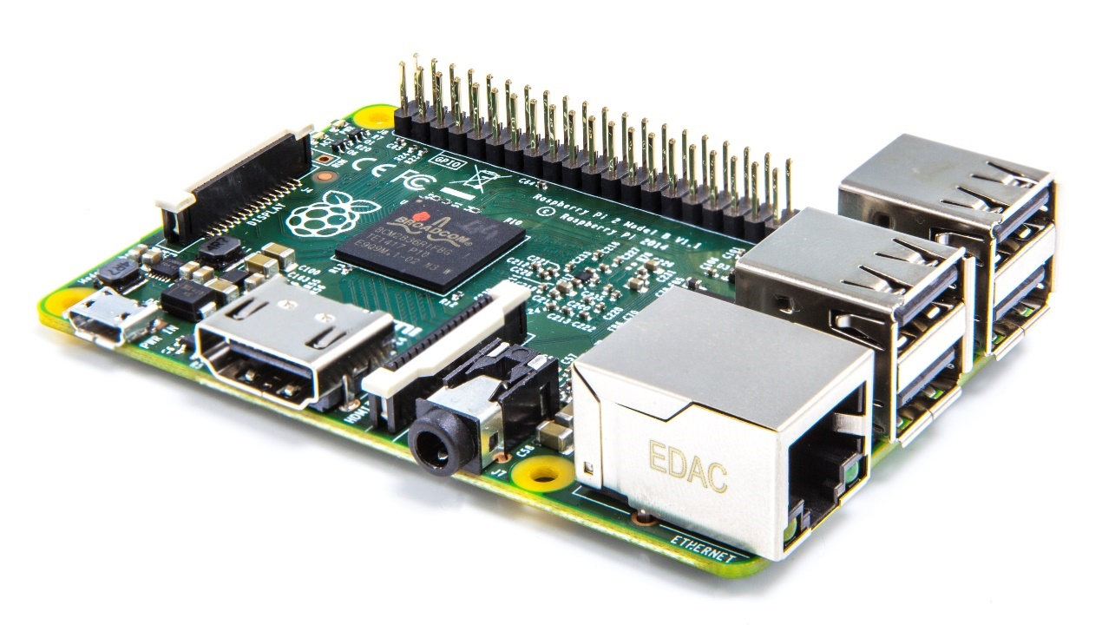
Hardwares…

Slide 15
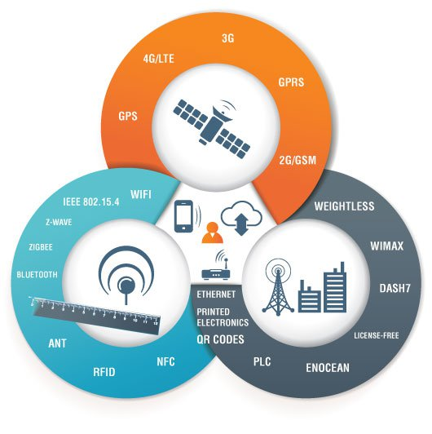
IoT Communication

Slide 16
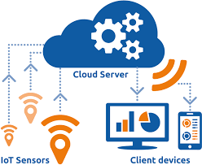
CLOUD IN IOT
The Internet of Things (IoT) involves the internet-connected devices we use to perform the processes and services that support our way of life. Another component set to help IoT succeed is cloud computing

Slide 17
FREE CLOUDS FOR IOT
1)www.thinkspeak.io
2)www.thinger.io
3)www.thingsboard.io

Slide 18
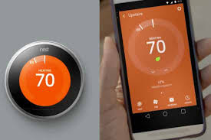
1. Nest Smart for fHome Nest thermostat
REAL TIME IOT EXAMPLES

Slide 19
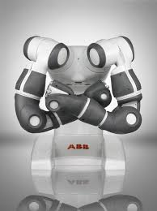
REAL TIME IOT EXAMPLES
ABB: SMART ROBOTICS

Slide 20
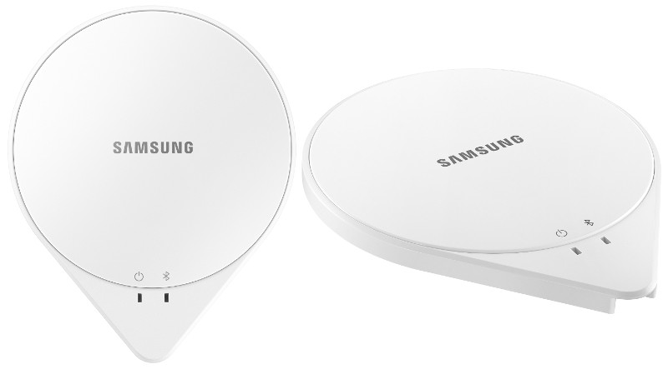
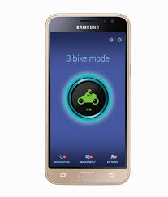
SAMSUNG SLEEP SENSE
REAL TIME IOT EXAMPLES

Slide 21
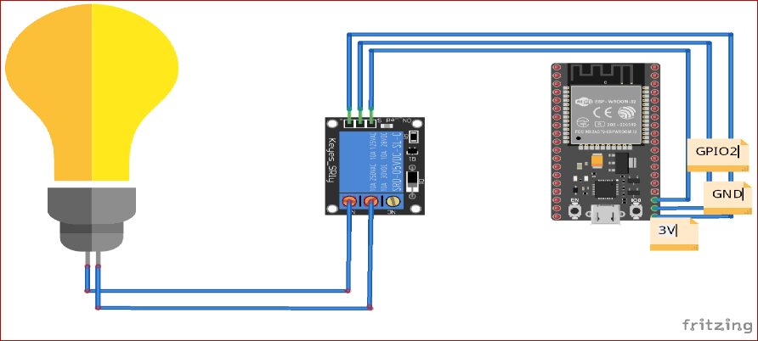
Mini Project : Home Automation using Adafruit io

